Slide 1
Data Presentation and Visualization
Week 3 & 4
2.3 Project Task
Executive Summary
Professor : Dr. Catherine Williams
Assignment: Term Project 2.3 Executive Summary(Week 3&4)
Author: Karthikeyan Chellamuthu
Due Date: 07/02/2022

Slide 2
Highlights of Executive Summary
The main purpose of this summary analysis was to provide important facts about Airline travels are safe.
Especially due to COVID lot of travel industries airline booking and subsequent cancellations are causing airline partners owners the constant headache of losing business.
Discuss about the impact of negative publicity by media on sales based on the sentiments.
Comparing the analytical results of airline incidents and fatalities historical data is compared with latest data of worldwide airlines.
Airlines economical data is considered to see if there is any impact of overall profit and public demand.
Discuss about the ethical concerns of Assessing only relevant information required for this analysis.

Slide 3
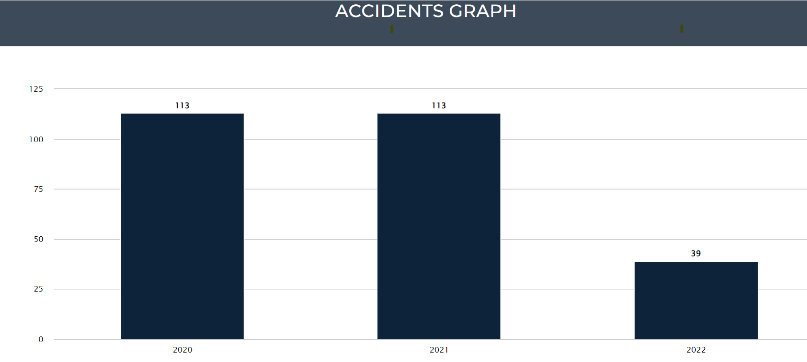
How safe to travel in Airline ?
The Airlines accidents are ONLY 0.07% of motor vehicles
Fatality Rate of Airlines for Year 2022 is much lesser than Roadways
Based on these number of accidents Air travel is one of the safest form of transport

Slide 4
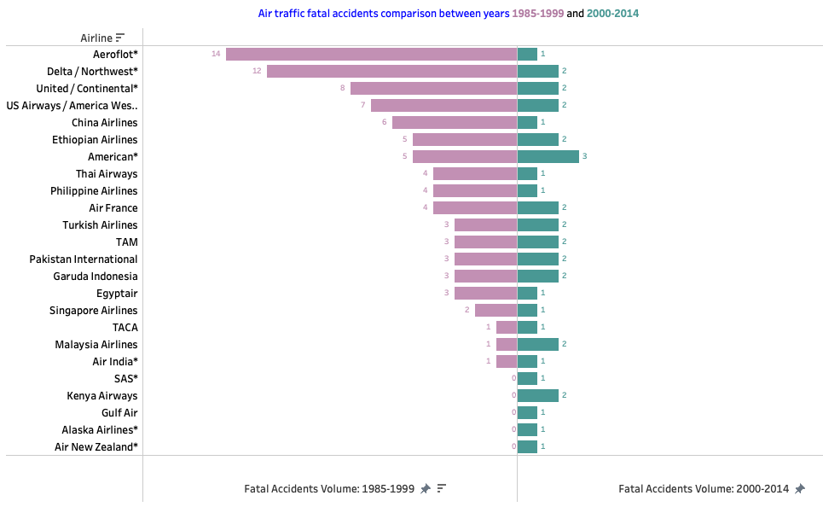
Fatal incidents comparison vs recent years?
Considerably very less in 20th century (2000-2014) compared to prior years of 19th century(1985-1999)

Slide 5
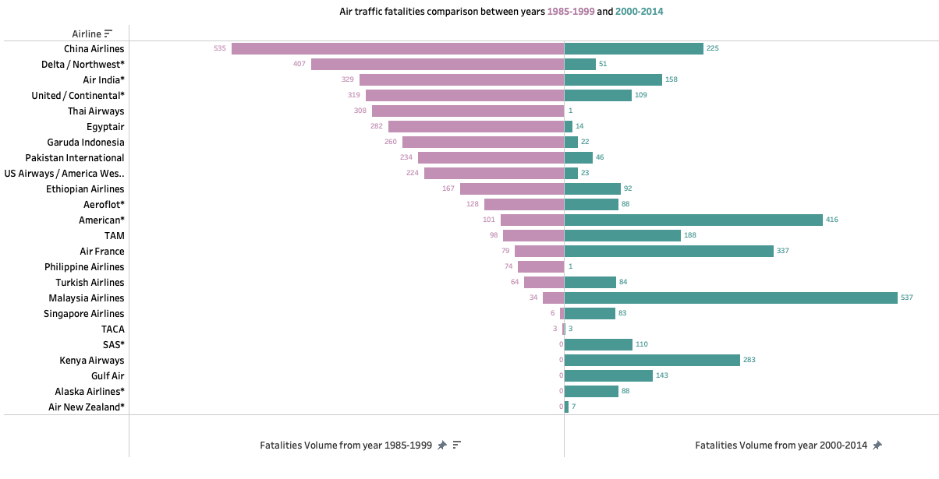
Summary of air traffic fatalities
Fatalities caused by air traffic accidents are gone down and its very less in the 20th century (2000-2014) compared to prior years of 19th century(1985-1999)

Slide 6
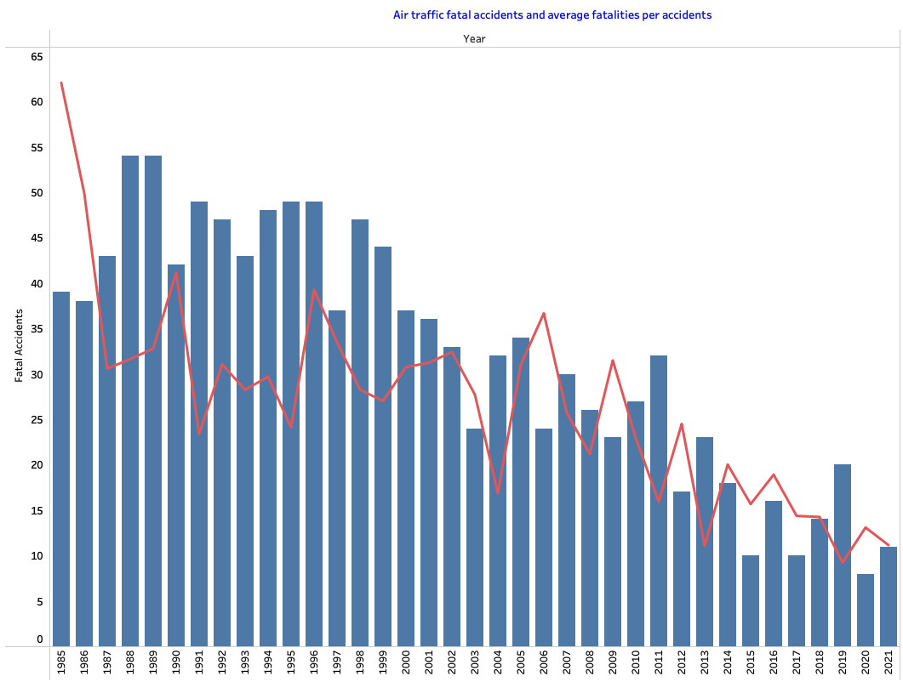
Average fatalities rates trend
The trend is down towards the recent years of Airlines fatal accidents which is an indication of higher in safety sentiments.

Slide 7
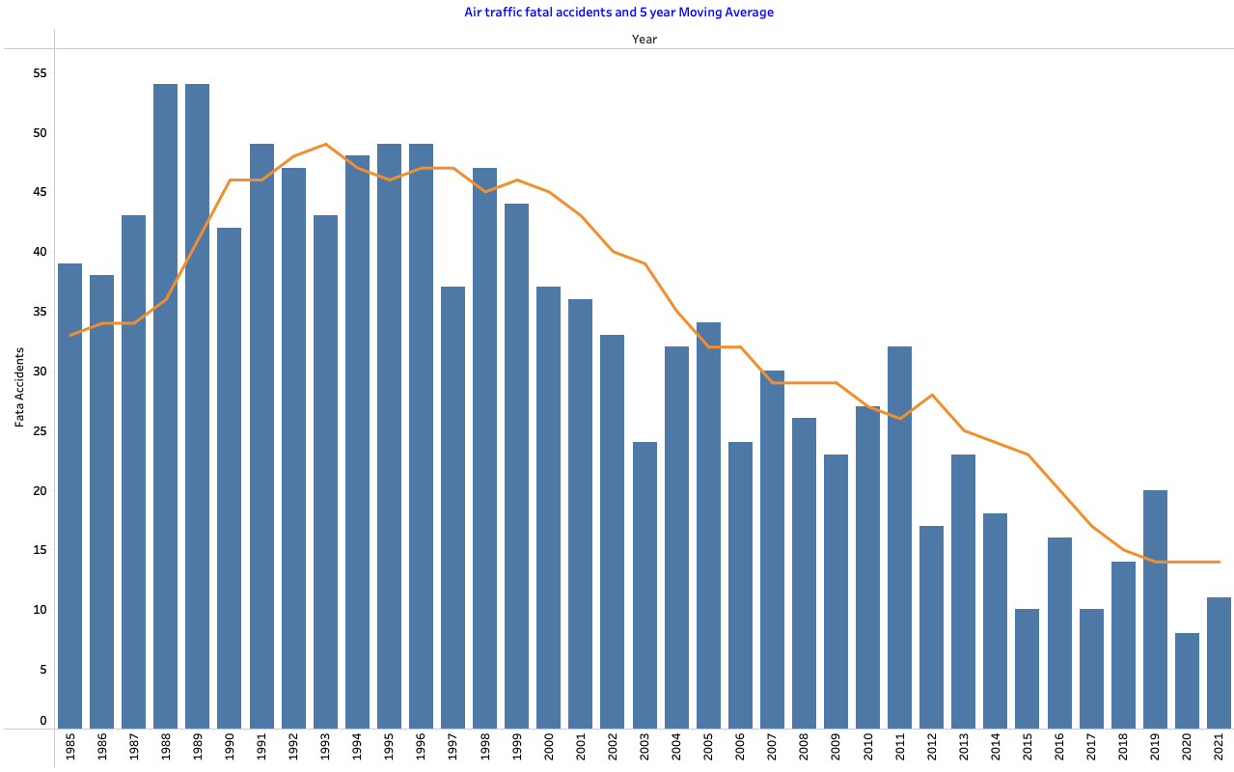
Moving average trend for 5 years.
The Airlines fatal accidents and 5-year moving average are drastically down

Slide 8
Impacts caused by any negative media news?
There is no negative media news of negative sentiments impacting the airline industry for sure.
Airlines available seat multiplied by air miles is increasing, and increased in domestic travel volume.
Air travelers are eagerly waiting for the COVID endemic to travel back as before.
New regulations in place for safe travel during COVID and increased hospitality services with in the aircraft.
The Airlines overall profit is growing in recent years
Demand for Air travel is increasing as airlines average passenger miles is increasing
Based on these airlines year over year net profit, its capacity and public demand to air travel increasing

Slide 9
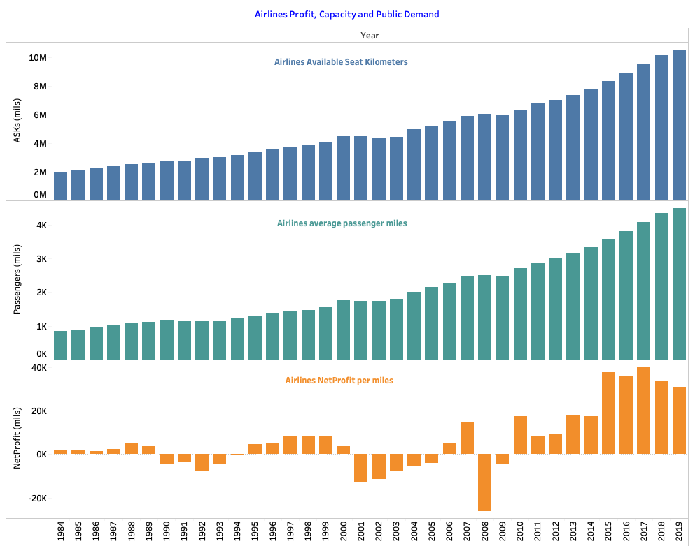
Impacts caused by any negative media news? Bar Charts

Slide 10
Recommendations
Based on this analysis, we were able to clarify few things and could recommend to make more consumers to understand why air travel is safest:
Airline travel is still safest way of travel should be carried to all country .
You are nineteen times safer in a plane than in a car, these data sets needs to be carried to other countries.
Airlines and airports should offer many forms of travel assistance that make air travel for seniors much easier to manage.
There is no impact on net profit and public demand of air travel is increasing and will improve sales.
Management can attract more passengers by providing some offers and compliments
Today's airplane safety feature should be explained to passengers.
Such as seat can successfully withstand 16 times gravity's force. In addition to that, the cushions and fabrics are self-extinguishing and don't emit any toxic smoke.

Slide 11
Legal and Ethical Considerations
Data obtained here from public domains and was no PII information on it.
We are not using any passenger personal information such as address or geo locations to navigate these results.
The data considered for the analysis are provided by government for public consumer benefits
There are no private data has been disclosed here and no airline company highlighted
Assessing only relevant information required for this analysis
Publish and Validating the data with respect to the graph
Communicating the results appropriately
There are no restrictions to use this data for Analysis and academic purpose

Slide 12
Conclusions
Based on this analysis, we were able to clarify and conclude few things:
Airline travel is still safest way of travel.
There is no impact on net profit and public demand of air travel is increasing and will improve sales.
For all passengers the government regulation on seats on an airplane have met strict standards for head-impact safety and durability.
You are nineteen times safer in a plane than in a car.
Air travel resulted in 0.07 deaths for every 1 billion miles travelled compared to 212.57 for motorcycles and 7.28 for cars.

Slide 13
References
Government and other website used for data collections and analyze the fatalities
https://cdan.dot.gov/SASStoredProcess/guest
https://www.airlines.org/dataset/world-airlines-traffic-and-capacity-2/
https://www.statista.com/statistics/263443/worldwide-air-traffic-fatalities/#professional
https://docs.google.com/spreadsheets/d/1SDp7p1y6m7N5xD5_fpOkYOrJvd68V7iy6etXy2cetb8/edit#gid=1448957446

